Slide 1
VIRTUAL LEARNING RESOURCES SUBJECT-ENGLISH CLASS-IV

Slide 2
Dear Students
How we’d love to have you back at school
Watch you run into the classrooms and make new friends.
Filling the hallways with your joyous laughter and cheer
Eager to learn new skills, explore, grow and pick up the latest trends.
Strange beginning to the year though this be
Bound to our homes, a brand new session is all set to start.
We welcome you, albeit virtually, with open arms
As these special classes promise to make your learning smart.

Slide 3
Books
Mayflower: An Integrated Semester Book1-Indiannica Learning
Supplementary Reader: Alice in Wonderland- Scholastic
MBIIS Poetry Book

Slide 4
SYLLABUS: CYCLE 1
Literature:
Chapter 1: The Raindrops
Poem: The Giraffe
Grammar
Nouns, Types of Sentences
Supplementary Reader: Alice in Wonderland
Chapters:1-3
Reading and Writings
Unseen Comprehension Passage, Creative Writing with story prompts, Picture Composition

Slide 5
RECAPITULATION
NOUN AND IT’S KINDS:PART 1

Slide 6
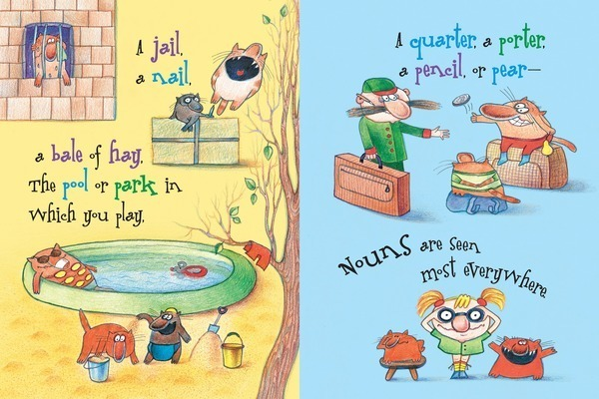
What is a Noun?
A Noun is a word that names a person, place, animal, thing or idea.
Examples: baby,
Taj Mahal, school, sadness

Slide 7
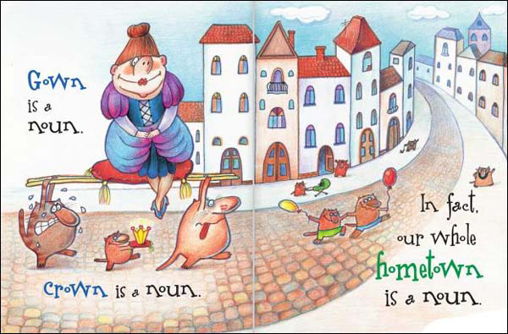
What is a Noun?....Contd.

Slide 8
KINDS OF NOUNS
Proper Noun
Common Noun
Collective Noun

Slide 9
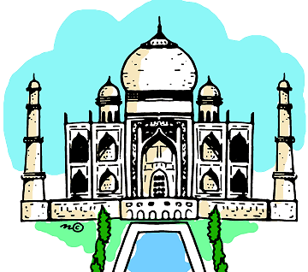
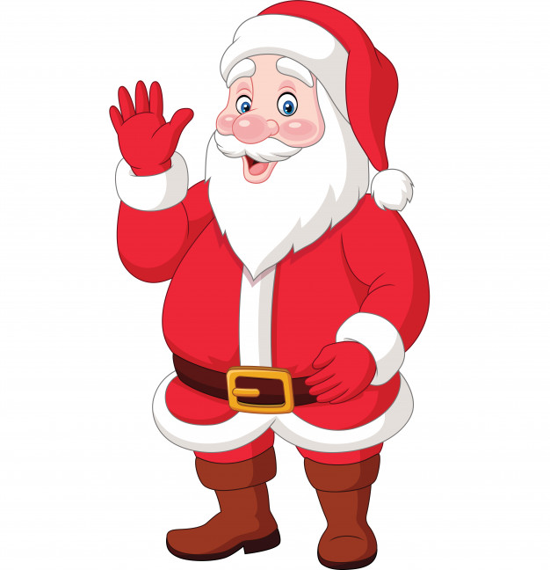
PROPER NOUN
A noun that names a specific person, place or thing.
Proper nouns always start with a capital letter.
Taj Mahal Santa Claus Friday

Slide 10
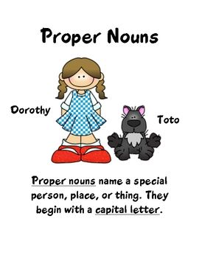
Proper Nouns are:
Names of people: Kapil, Ritu, Elizabeth
Buildings/Monuments: Taj Mahal, Eiffel Tower, India Gate
Place: Europe, London, Sahara Desert
Events: Olympic Games, Republic Day, Christmas
Months/Days of Week: January, May, Friday

Slide 11
Examples: Proper Noun
Ashoka was a wise king.
Australia is one of my favourite places to visit.
I ordered the books from Amazon.
He goes for a walk, by the river every Monday.
Ritu has a dog named Poppy.

Slide 12
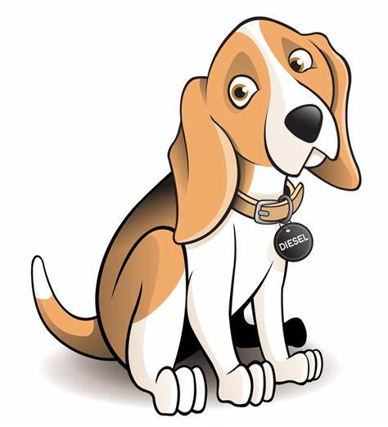
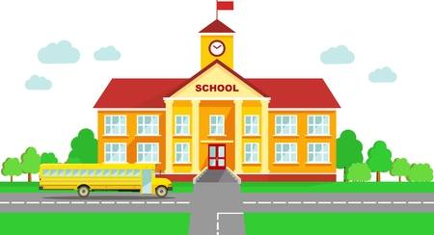
COMMON NOUN
It is the name of a person, place, animal or thing in general.
Examples: girl, school, dog, chair
dog school girl

Slide 13
Common Nouns include:
People: boy, lady, son , grandfather, nephew etc.
Animals: lion, giraffe, tiger, cat, etc.
Places: mall, market, school, hospital, library etc.
Things: television, computer, spoon, fork, etc.

Slide 14
Examples: Common Noun
I have bought a new jacket.
My car is parked in the driveway.
Ali has broken my pen.
A cat may scratch you if it is teased too much.
The planet Jupiter has more than seventy five moons.

Slide 15
COMMON NOUN | PROPER NOUN
man | Sachin Tendulkar
mountain | Kanchenjunga
ocean | Indian Ocean
chocolate | Snickers
country | India, Germany
cat | Button, Fluffy
movie | Spiderman

Slide 16
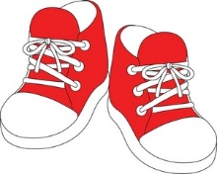
COLLECTIVE NOUN
It denotes collection or a group of people, animals, places or things taken together and spoken of as a whole.
Examples:
a school of fish a bouquet of flowers a pair of shoes

Slide 17
Examples: Collective Noun
The pop group will go on world tour next month.
Our cricket team has many good players.
There is a swarm of bees around the tree.
The audience was happy with the stage performance.
The boat’s crew worked all night to stop the leak.

Slide 18
Some more Collective Nouns……..
A group of…… | Collective Noun
players | team
thieves | gang
students | class
teachers | staff
soldiers | army
wolves | pack
bees | swarm
keys | bunch
owls | parliament
stairs | flight
cubs | litter
cakes | batch

Slide 19
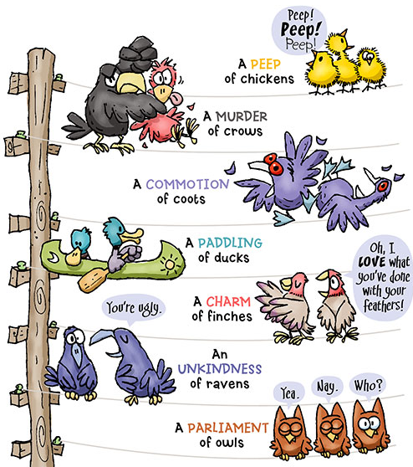
Some Unusual Collective Nouns

Slide 20
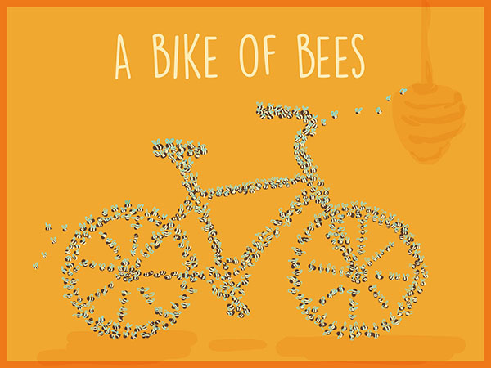
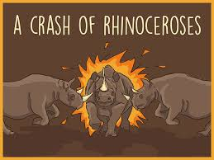
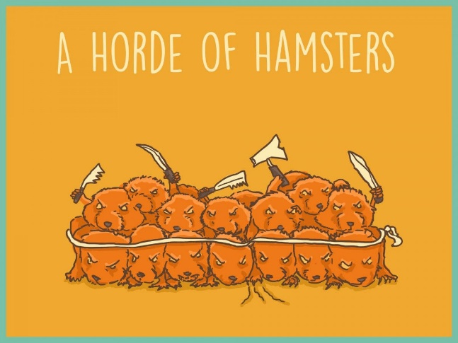
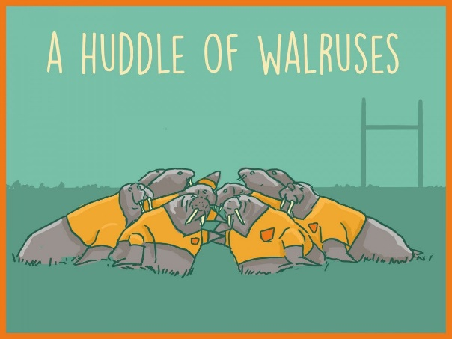
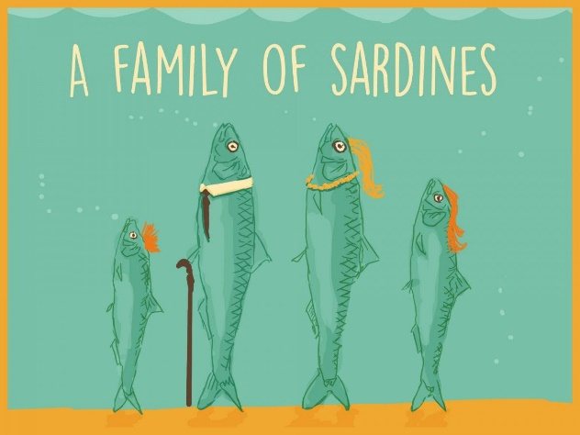
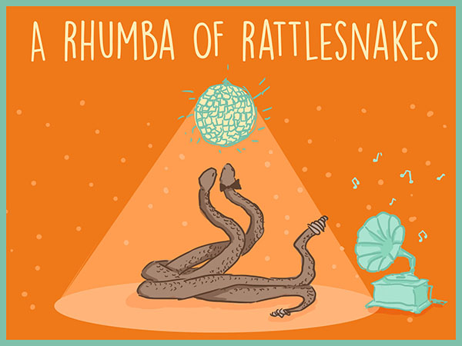
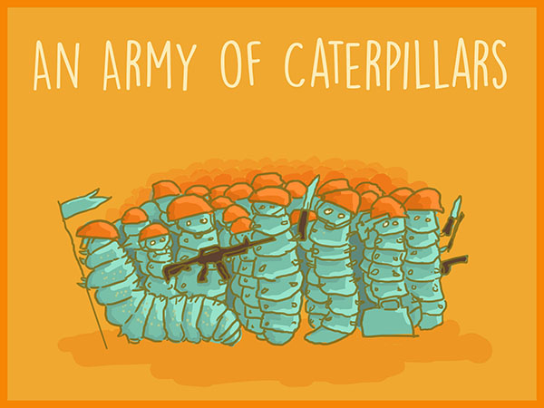
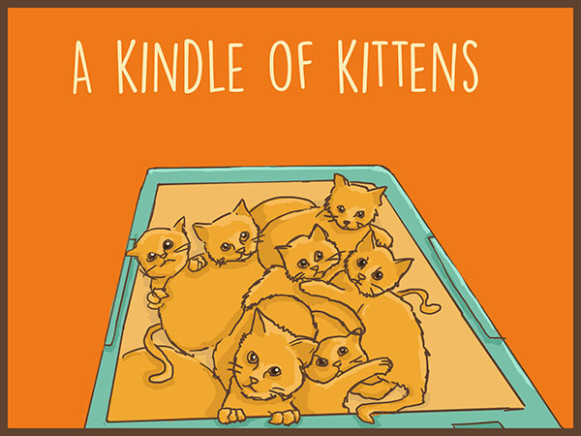
Unusual Collective Nouns…..continued

Slide 21
Let’s Practise Write as many Common Nouns as you can think of, for the given Proper Nouns in a notebook and show it to the subject teacher when the school reopens.
 | PROPER NOUN
COMMON NOUN | Raman
 | Amitabh Bachchan
 | Australia
 | Alice in Wonderland
 | Volvo
 | Sunday
 | Qutub Minar
 | Samsung
 | Titanic

