Slide 1
VIRTUAL LEARNING RESOURCES SUBJECT-SCIENCE CLASS-VI

Slide 2
BOOK PRESCRIBED
SCIENCE SUCCESS
It entails:
Physics
Chemistry
Biology
In total 16 Chapters

Slide 3
SYLLABUS
CHAPTER | NAME | SUBJECT
1. | Food: Where Does it Come From? | Biology
2. | Components of Food | Biology
3. | Fiber to Fabric | Chemistry
4. | Sorting Materials into Groups | Chemistry
5. | Separation of Substances | Chemistry
6. | Changes Around Us | Chemistry
7. | Getting to Know Plants | Biology
8. | Body Movements | Biology
9. | The Living Organisms & their Surroundings | Biology
10. | Motion & Measurement of Distances | Physics
11. | Light, Shadows & Reflections | Physics
12. | Electricity & Circuits | Physics
13. | Fun with Magnets | Physics
14. | Water | Biology
15. | Air Around Us | Chemistry
16. | Garbage in, Garbage out | Biology

Slide 4
SYLLABUS
(APRIL-MAY)
Chapter-1 Food: Where Does it Come From? (BIOLOGY)
Chapter-3 Fibre to Fabric (CHEMISTRY)
Chapter-11 Light, Shadows and Reflection (PHYSICS)

Slide 5
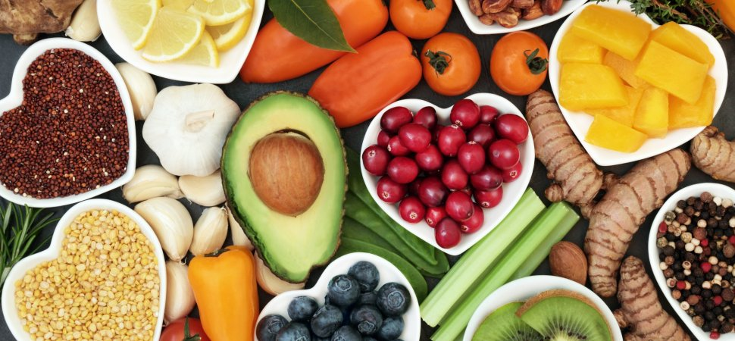
CHAPTER-1
FOOD WHERE DOES IT COME FROM?

Slide 6
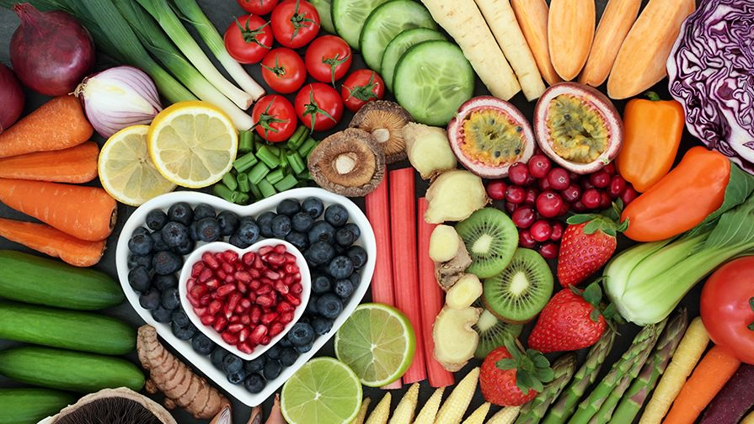
WHAT IS FOOD?
Any nourishing substance that is eaten, drunk, or otherwise taken into the body to sustain life, is called food.

Slide 7
Why do we need Food?
We know that all living things be it plants and animals need food and water to live on.
We need food because food gives us energy.
Food we eat gives our body essential nutrients to help us grow and heal when we are injured or we are ill.
Thus food keeps us healthy and provide us essential nutrients to fight diseases.

Slide 8
IMPORTANCE OF FOOD
FOOD
PROVIDES
PREVENTS
CONTAINS
STARVATION
MALNUTRITION
CAROHYDRATES
NUTRITION
FATS
PROTIENS
ENERGY
MINERALS AND VITAMINS
REPAIR
GROWTH

Slide 9
Explanation of the above slide
1.food provide us nutrition which helps us to grow, repair our worn out tissues and gives us energy.
2. Food also prevents starvation(hunger) and malnutrition(lack of proper nutrition, caused by not having enough to eat).
3. Food contains nutrients like carbohydrates, fats,protiens vitamins and minerals.

Slide 10
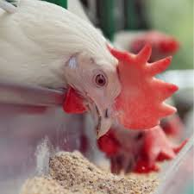
SOURCES OF FOOD
Plants and animals are the two main sources of our food.
Milk, egg, meat, chicken, fish, prawn, beef, pork etc. are the food products that we get from animals
Grain, cereals, vegetables and, fruits comes from plants and plants products
We eat leafy vegetable, fruits, and some parts of plants like stem and roots.

Slide 11
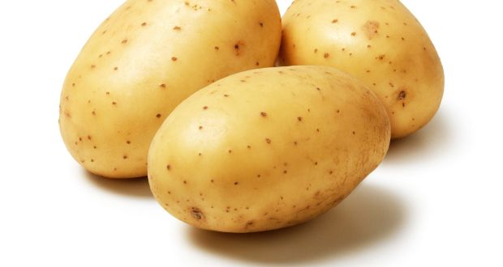
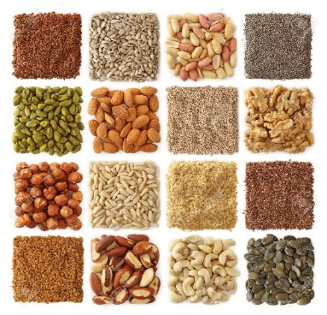
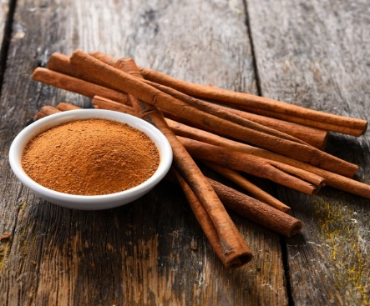
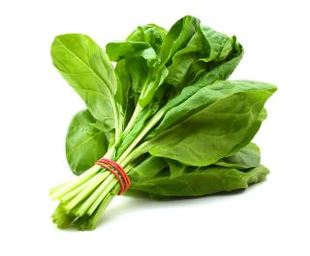
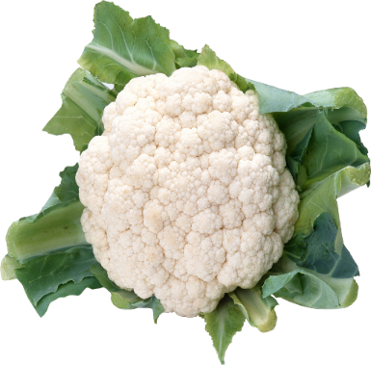
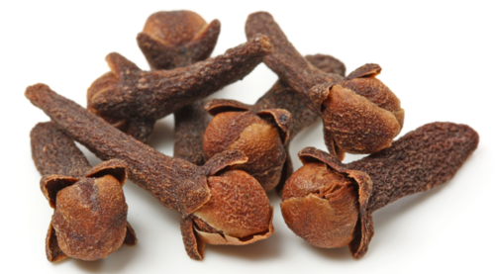
PLANT PARTS AS FOOD
Some examples of edible plant parts are shown in the image and their examples are given
Roots: beets, carrots, radishes, turnips, ginger,
Stems: broccoli stem, bamboo shoots, sugar cane, potato
Leaves: spinach, lettuce etc.
Fruits: apple, pear, tomatoes, grapes, cherries, oranges
Edible Flowers: broccoli heads, cauliflower heads
Seeds: sunflower seeds
Buds: clove

Slide 12
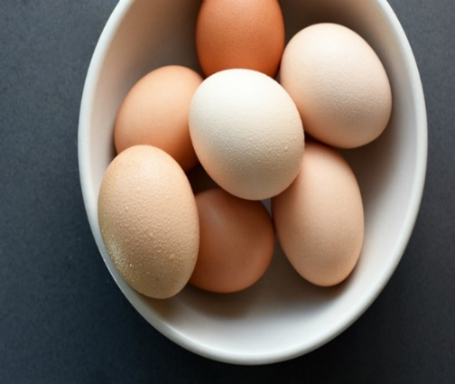
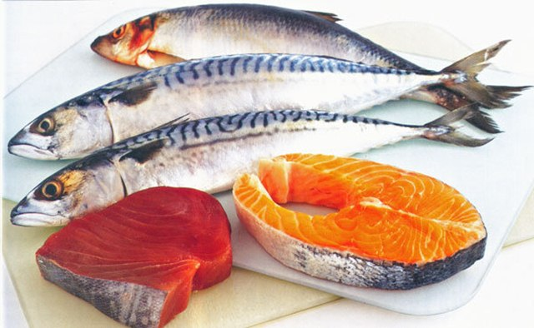
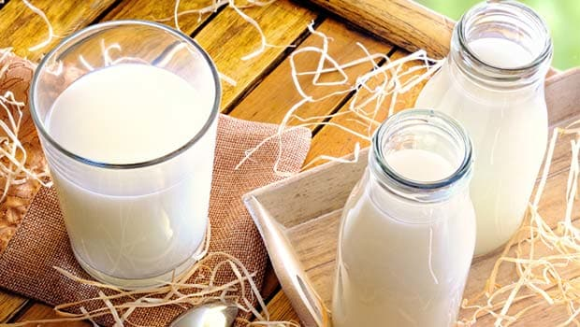
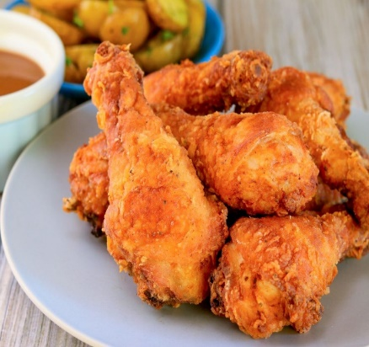
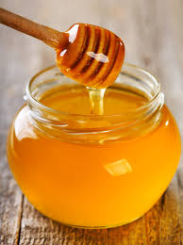
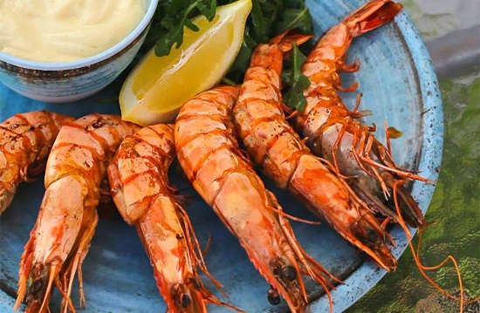
ANIMAL PRODUCTS AS FOOD
Animal products which are used as food are
Eggs, chicken, mutton, fish, honey, milk etc. Milk is used for drinking purpose, converted into other useful products such as curd ,butter , ghee, cheese. Fish gives us cod liver oil which is rich in vitamin A. Honey is produced by honey bees.

Slide 13
SPROUTS
Sprouts are the white root like structure coming out of seeds when soaked in water overnight
Sprouts contain
High levels of fiber
Vitamins and
Proteins

Slide 14
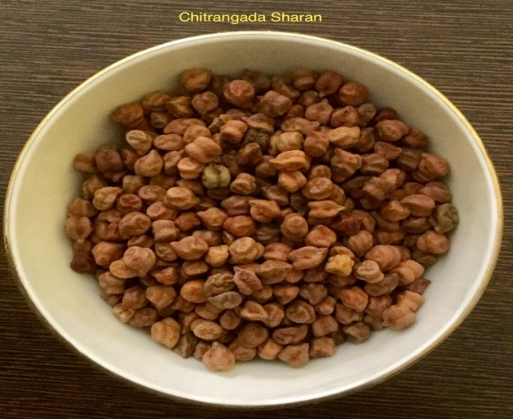
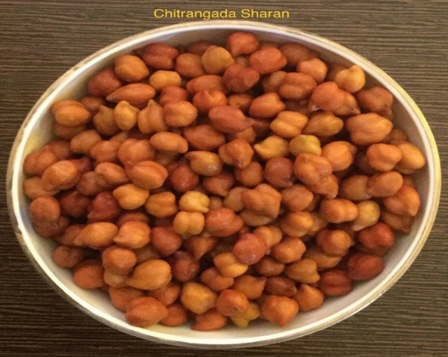
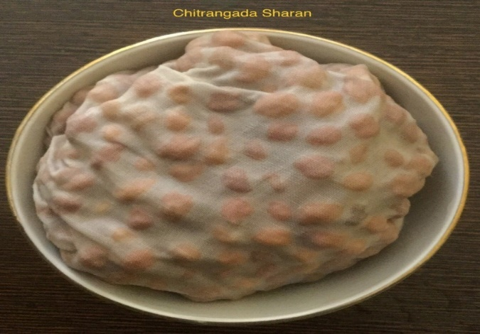
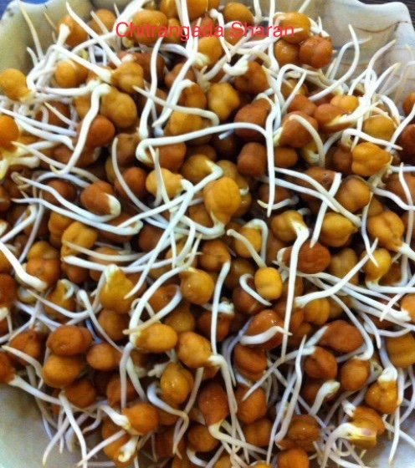
HOW TO PREPARE SPROUTED SEEDS?
Watch the given link and grow your own sprouts.
https://www.youtube.com/watch?v=oRKbFP7KUIQ

Slide 15
QUESTIONS FOR REFLECTION
1. Which food are more nutritious sprouts or pulses. Why?
2. Why do you think we need food?
3. What are the two main sources of food?
4. How do seeds sprout?
5. Conduct an experiment at home under parental supervision to understand the process of sprouting.
You can also visit the following sites for more information
https://www.youtube.com/watch?v=rGMHMXisTvY

