Slide 1
Virtual Teaching learning Process SOCIAL SCIENCE
CLASS – V
PERIODIC ASSESSMENT I (2020-21) Chapter 1: Globes and Maps
Chapter 2: Rotation and Revolution

Slide 2
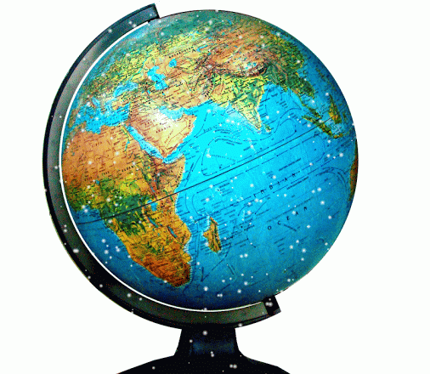
What is a Globe?
Part – I Globes and Maps
A globe is a small-scale three dimensional MODEL OF THE EARTH.
It is mounted on an axis so that it can be rotated freely just like an earth.

Slide 3
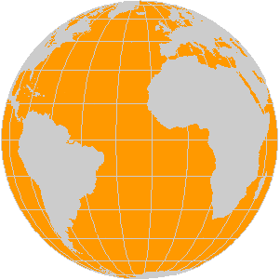
Globe shows that the shape of earth is like an orange.
It is flat at the poles and bulges in between.
This type of shape is also called sphere or Geoid

Slide 4
Important parts of a globe
The axis is an imaginary line through the center of Earth, around which the planet rotates.
There are two very important points i.e. North Pole and South Pole
The North Pole is the northern end of earth’s axis and South Pole is southern end.
The Equator is an imaginary circle around earth. It divides Earth into two equal parts: the Northern Hemisphere and the Southern Hemisphere.

Slide 5
Types of Globes
There are different types of globes
A globe of Earth is called a terrestrial globe.
A globe of the celestial sphere is called a celestial globe.

Slide 6
The word "globe" comes from the Latin word globus, meaning "sphere".
Globes have a long history. The oldest surviving terrestrial globe is the Erdapfel, wrought by Martin Behaim in 1492.

Slide 7
ADVANTAGE OF GLOBE
Shows exact shape of the earth- spherical slightly flattened at the poles and bulging at the equator.
The shape of continents and oceans are shown accurately.
The different physical features are also marked more ore less accurately.

Slide 8
DISADVANTAGES OF GLOBE
Bulky and can not be stored easily
It can not show the details of landforms and location of small towns.
It can not provide detail information about climate, vegetation agriculture etc.
Although larger globes show some details they are difficult to carry and handle

Slide 9
It’s time for a
Write your answer below in the slide where space is given
THANK YOU FOR WATCHING
This is end of part I

Slide 10
1. Imaginary line running on globe that divide it into two equal part is called
Line of cancer
Axis
Line of Capricorn
Equator
Answer: _________________
2. The globe can be moved around axis form
North to south
West to east
East to west
South to north
Answer: _________________

Slide 11
3. A line fixed through a globe in tilted manner is called is called
Latitude
Altitude
Axis
Lucan
Answer: _________________
4. What is the meaning of Latin word Globus
Circle
Sphere
Going around
Moving
Answer: _________________

Slide 12
5. The shape of earth is :
Oval shaped
Orange shaped
Exactly round
Pear shaped
Answer: _________________
6. Earth is represented nearly perfect by :
Topographic chart
3-D map
A globe
A map
Answer: _________________

Slide 13
7.On the globe countries, oceans and continents are shown in:
Incorrect size
Actual size
Enlarged size
Correct size
Answer:_____________________
8.DO YOU KNOW WHAT IS AXIS?
WRITE YOUR ANSWER
(Use your own words)
____________________________________________________________________________________________________________________________________________________

