Slide 1
KNF
MANAVA BHARATI INDIA
INTERNATIONAL SCHOOL
VIRTUAL LEARNING
CLASS –V
SCIENCE (2020-21)

Slide 2
SCIENCE CURRICULUM CLASS –V Mayflower : An integrated semester book
PERIODIC ASSESMENT -1 WEIGHTAGE- 50 MARKS
CHAPTER 1- PLANT REPRODUCTION

Slide 3
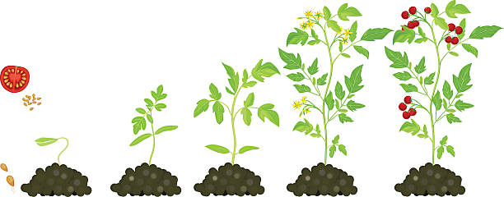
INTRODUCTION
Planting and watching seeds grow is a wonderful experience for children.
A seed is a like a magic, a seemingly lifeless thing that can grow into a living plant.
In this topic we will learn about germination and conditions required for germination.

Slide 4
GERMINATION
The process by which a seed grows into a seedling is called germination.
A seed needs right conditions to germinate.
They are

Slide 5
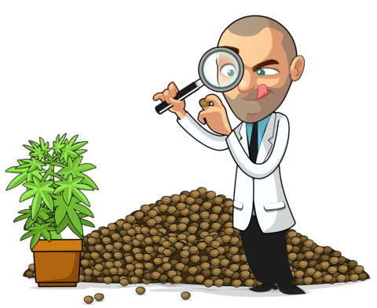
CONDITIONS NECESSARY FOR GERMINATION
AIR
WATER
WARMTH

Slide 6
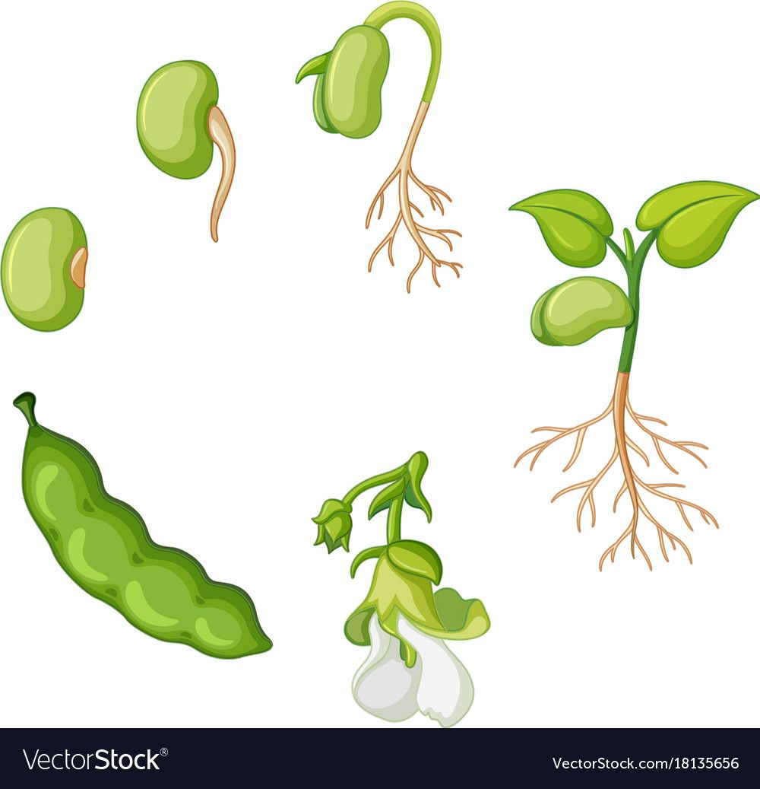
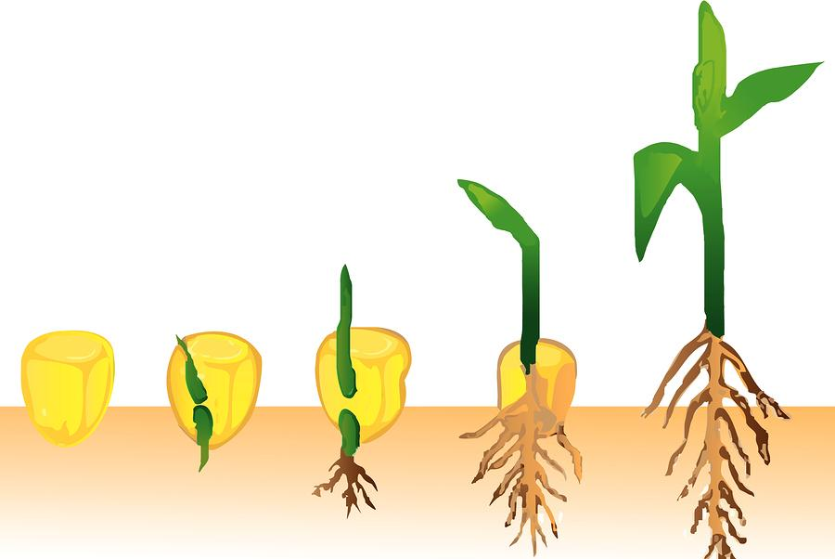
STAGES OF GERMINATION
Plant grows and leaves develop in it. Cotyledons shrink and disappear
Seed coat breaks and the baby plant grows
Roots and shoot develop in baby plant and form seedling or young plant
The seed gets water, air and warmth

Slide 7
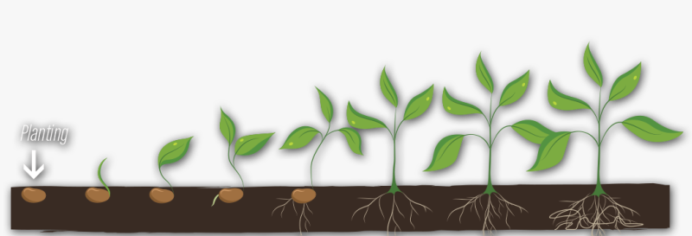
CONDITION NECESSARY
Air helps the germinating seeds to breathe.
Water softens the seed coat making it easy for the baby plant to come out.
Sunlight provides the warmth for germination.

Slide 8
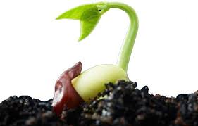
CONTINUED
In the beginning of germination the seed ling gets its food from the cotyledons
After that when the root and the shoot comes out, it gets water and nutrient from the soil and leaves prepare food for the growing plant

Slide 9
RECAPITULATION
The process by which a seed grows into a seedling is called germination.
When seeds get enough water, air and sunlight( warmth) they grow into new plants.
Conditions necessary for germination are water, air and sunlight (warmth)

Slide 10
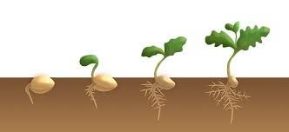
FOLLOW UP EXERCISE
Define germination
Name the conditions necessary for germination.

